Slide 1
Decision Tree Classification
Notes:
https://thatascience.com/learn-machine-learning/gini-entropy/

Slide 2
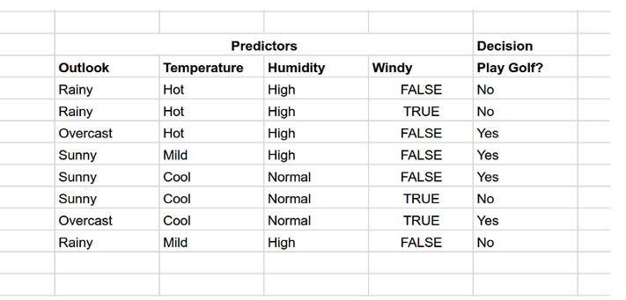

Slide 3
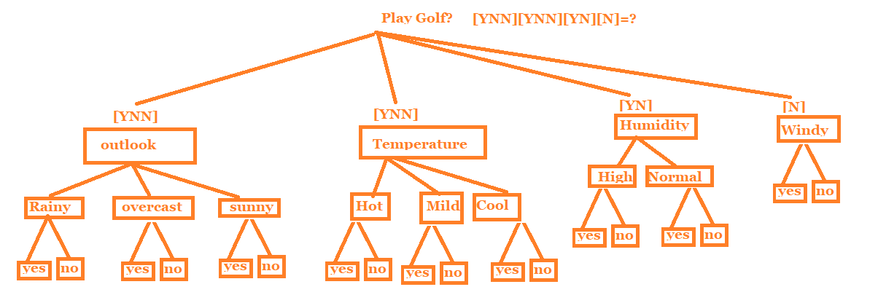
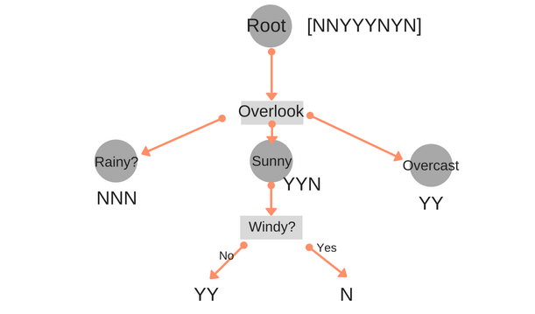

Slide 4
Decision Tree Classification
Decision Tree classification works on the same concept of Decision Tree Regression.

Slide 5
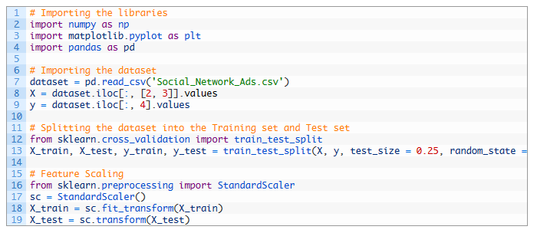
Data Preprocessing:

Slide 6
Data Preprocessing:
We read “Social_Network_Ads.csv” file and stored in dataset.
Extracted age and salary information from dataset and stored in X
Extracted purchase information from dataset and stored in Y.
Split dataset in training and test set so that machine can be trained using X_train and Y_train
Used feature scaling for X_train.

Slide 7
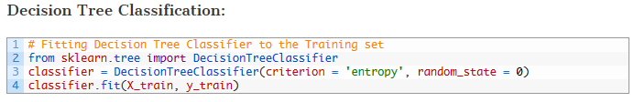

Slide 8
Imported DecisionTreeClassifier from sklearn.tree
Created a classifier and applied a widely used ‘entropy’ criterion to it
fitted classifier with training data set

Slide 9
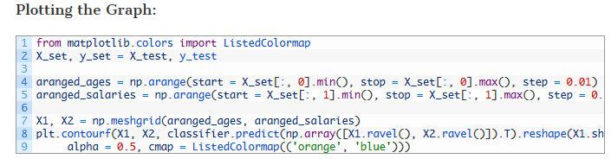

Slide 10
Decision Tree Classification
aranged_ages variable will have scaled ages of users starting from minimum age to maximum age incremented by 0.01.
aranged_salaries variable will have scaled salaries of users starting from minimum salary to maximum salary incremented by 0.01.
np.meshgrid() takes aranged_ages and aranged_salaries to form X1 and X2.
X1 and X2 are used for creating a graph which classifies all data points using decision tree classification. It is done using plt.contourf(), method.

Slide 11
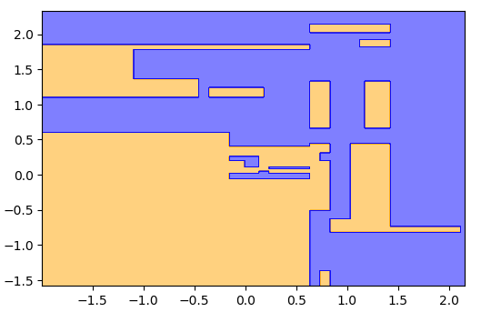
Data Preprocessing

Slide 12
Decision Tree Classification
Decision Tree does not draw any straight line, or a curve, it creates sections as shown in above graph
orange section is of users who will not buy the car and blue section is for users who will buy the car

Slide 13
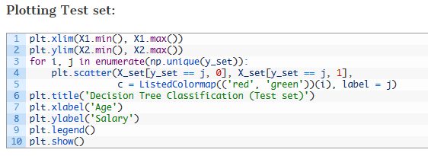

Slide 14
Decision Tree Classification
Above code plots actual data points in classification.
Red points denote users who did not buy the car
Green points denote users who bought the car.

Slide 15
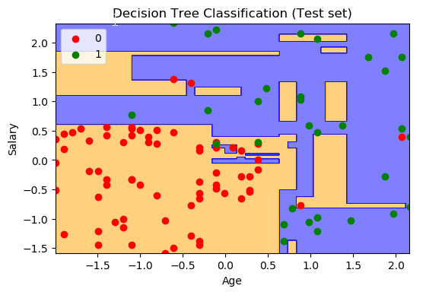

Slide 16
Decision Tree Classification
Note that we have plotted 100 observations from our test set and out of them
3 green points are observed on orange area
6 red points are observed in blue area
This means, out of 100 observation points, Decision Tree classification predicted 91 results correctly and only 9 are incorrect.

Slide 17
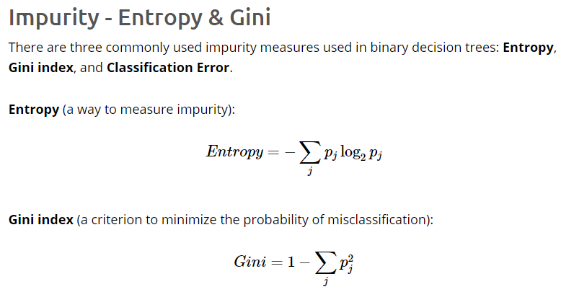

Slide 18
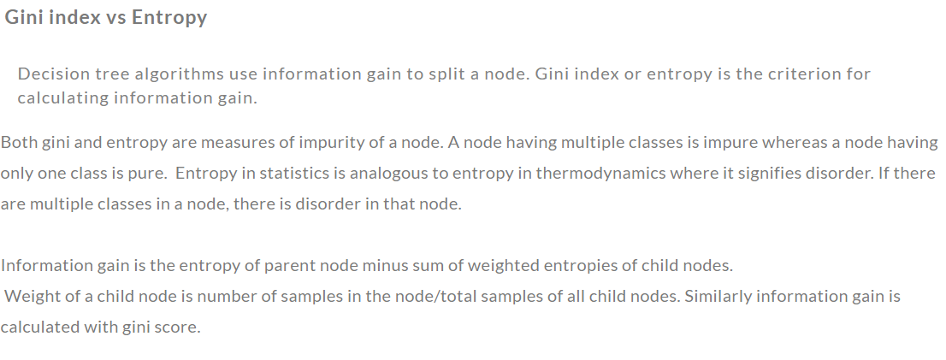

Slide 19
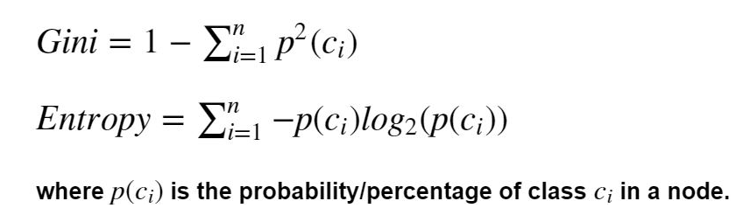

Slide 20
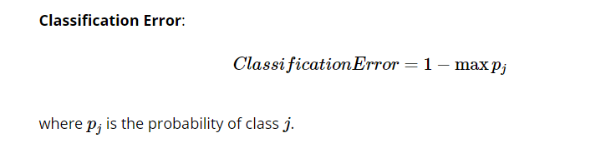

Slide 21
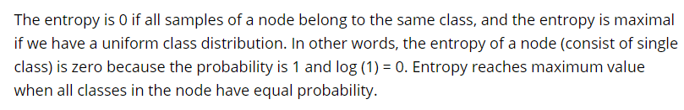

Slide 22
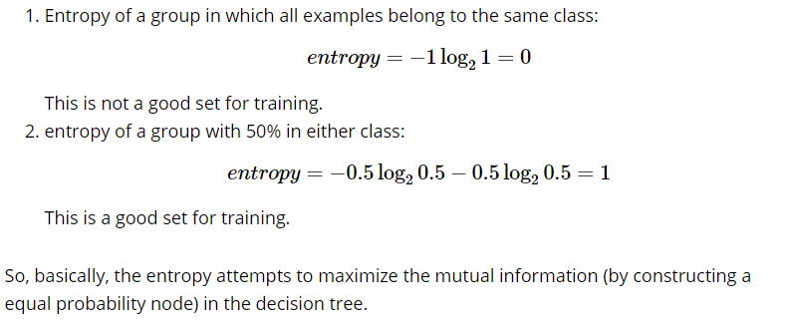

Slide 23
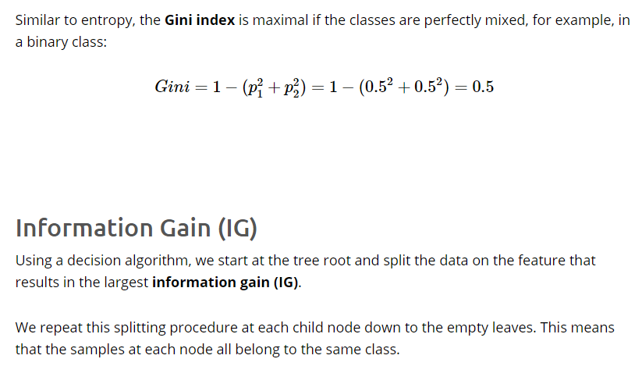

Slide 24
